Slide 1
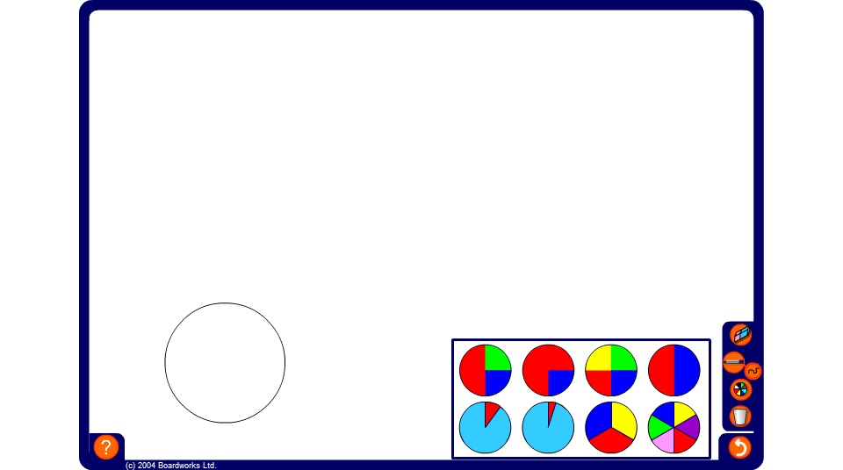


Spinners experiment
Notes:
Use the spinners experiment to compare the theoretical probability with the relative frequency for each spinner.
Notice that the more times the spinner is spun the closer the relative frequency gets to the theoretical probability.

